Slide 1
ENSE 477 March 25th Project Bazaar
URStreamSight
Avery Cameron, Raymond Knorr, Noah Rowbotham
March 25, 2021

Slide 2
Team Members
Avery Cameron
Project Management/Flexible Developer
Help with Front-End and ML as needed
Raymond Knorr
Lead API and Front-End Developer
Manage collaboration with Prairie Robotics
Noah Rowbotham
Lead Machine Learning Technician
Lead development of classification model and documentation
Notes:
Avery Cameron: Project Manager/Flexible Developer
Manage our GitHub, CI/CD and documentation
Help with Front-End and ML as needed
Raymond Knorr: Lead UI/API Developer
Manage communications, integration and documentation of our software with Prairie Robotics
Manage Trello board for workflow organization
Noah Rowbotham: Lead Machine Learning Technician
I lead development of machine learning training and implementation
I also develop for the aaeon computer on the trucks to collect our recycling data

Slide 3

Our Partnership
Developed in cooperation with our industry partner, Prairie Robotics
Progress made in our project will be used and expanded on by Prairie Robotics following its completion
Notes:
This capstone opportunity was made available to us by Prairie Robotics, a local startup here in Regina and it will be adopted and expanded on by them following its completion.

Slide 4
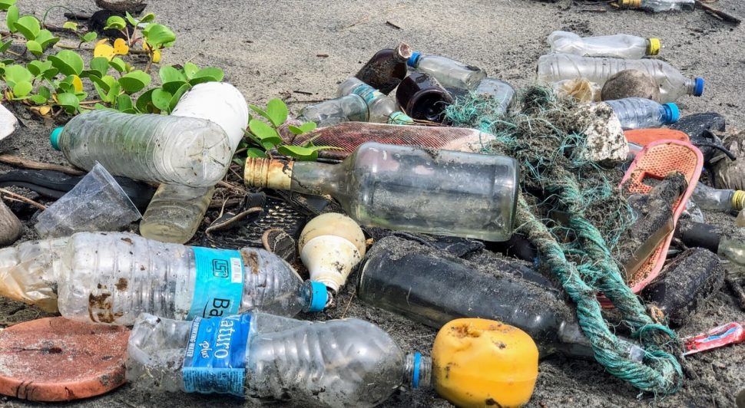
What is URStreamSight?
Problem:
Citizens across Canada are confused regarding what proper recycling is.
Gap we are filling:
Giving data to municipalities to allow them to track/correct problem at its source (the people recycling). We are not actually sorting any recycling.
Innovation we are introducing:
Web application for municipality workers that scores recycling on a neighborhood basis and displays the data. Videos are captured from the bin of recycling trucks and ran through a waste classifier to determine whether the recycling is contaminated.
Notes:
This is a web application to help reduce recycling contamination by allowing municipality workers to review contamination in recycling bins and display reports to help with decision making.
Pictures are captured when a bin is tipped into the recycling truck and contamination is identified with machine learning, this is then displayed in our front end portal for users.

Slide 5
Why URStreamsight?
Contaminated recycling generates fines for municipalities
Sorting recycling is complicated and expensive
Our three pillars:
Education
Regulatory compliance
Iteration
This is all based on various studies on recycling contamination impacts such as a Study from the Region of Peel (in Ontario) which showed that after education campaigns, 90% of people had less than 10% contamination compared to 60-70% of people before.
Notes:
Contaminated recycling generates fines for municipalities which increases costs for households. If the recycling is clean, recycling can instead provide revenue.
We have a 3 Pillar approach:
Education: The first step to fixing behavior is to raise awareness
Regulatory Compliance: The use of fines or loss of service to improve behavior
Iteration: Analyzing results of these two approaches to determine best method or combination
Our app provides these pillars to municipalities to help improve their recycling and reduce contamination.
Proof of the effectiveness of this approach is shown in the study from the region of peel, which is included in our references.

Slide 6
Scrum Dates
March 18, 2021 - March 25, 2021
Notes:
This scrum ran from March 18, 2021 - March 25, 2021

Slide 7

Status Description
API - Complete
Testing - Yellow
Front end - Complete
Machine Learning - Green
Image Pipeline - Complete
Overall - Green
Notes:
Disclaimer: the portions of our project labelled complete are at the stage we are comfortable leaving them at, but cleanup and small changes might still be done.
API Status: Complete
The API is complete and is hosted on AWS with automated deployment with the Serverless Framework via GitHub Actions. We improved our deployment times and response times recently. We also had a professional review done of our API code. We are working on implementing the feedback from the report.
Testing Status: Yellow
We are still working on testing for our API and improving our test coverage. It is yellow because we want to be further ahead with it but it will be the main focus in the next few weeks to complete this.
Frontend Status: Complete
Our completed frontend is hosted on AWS with GitHub Actions and has been kept up to date.
Machine Learning: Green
We have a contaminant classifier in place. We would like to improve it’s precision, especially the amount of false positives it detects, but we are quite happy with it. Our biggest drawback is the amount of data we have available.
Image Pipeline: Complete

Slide 8
Team Member Contribution
Avery
Infrastructure as Code
API Response Times
API Review and Testing
Ray
API Speed Improvements
Tying together full data pipeline
Noah
Completed bin detection process
Setup GPS & cellular internet for onboard computer
Integration tools research
Notes:
Avery:
I worked on Infrastructure as Code for Prairie Robotics to allow for quick deployment of the entire stack for demos and new environments. I also worked on API response times with Ray and the API review and testing
Ray:
I was working on speeding up the API Lambda function on AWS. This involved testing different amounts of memory for the Lambda, and removing unused dependencies. I also worked on integrating the full set of Lambdas and AWS integrations for our data pipeline.
Noah:
I also worked on prepping SSIO for a demo presentation, gps testing, and model training.

Slide 9
Project Issues and Changes
None at this time
Notes:
We haven’t encountered any project issues this scrum or made any changes.

Slide 10
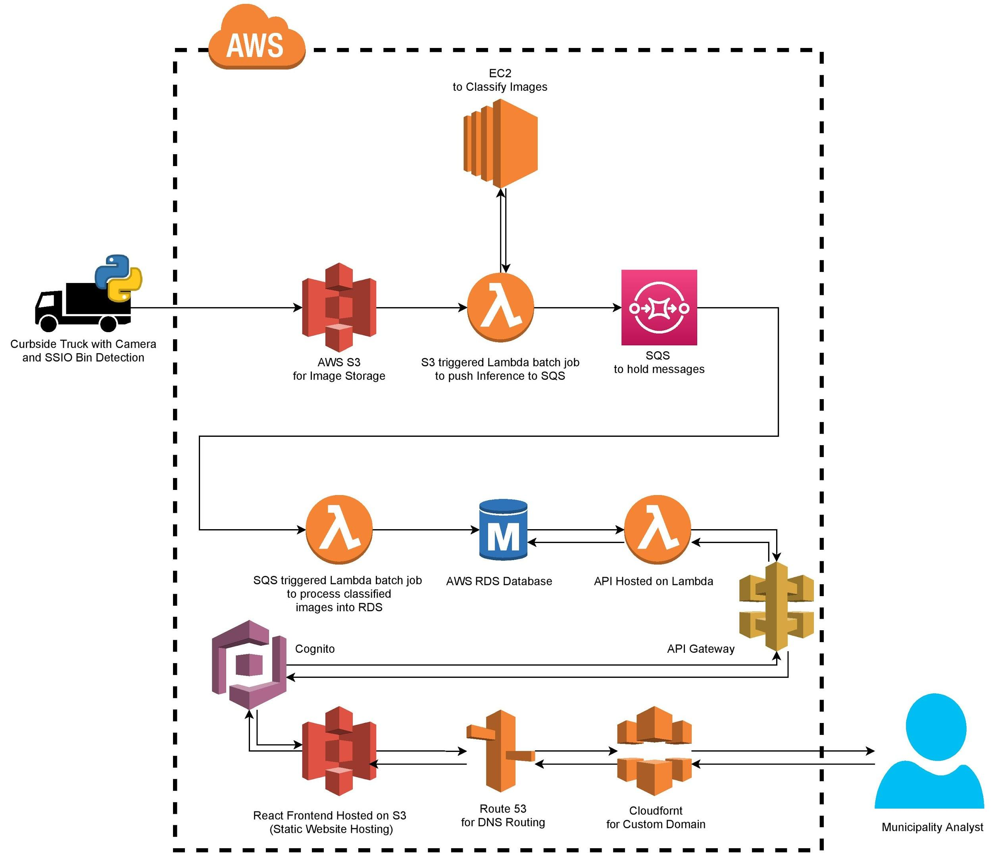
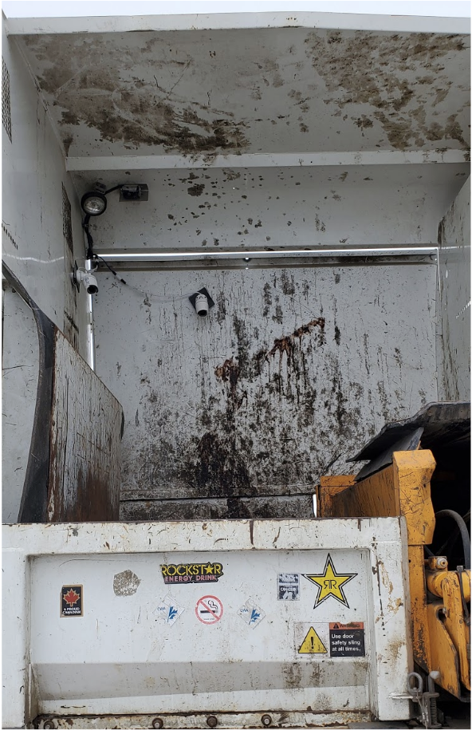
Project Demo:
Architecture
Notes:
Our architecture is hosted on AWS. Now for some definitions:
An S3 bucket is used to store files.
A Lambda allows code to run based on set triggers.
RDS stands for Relational Database System.
API Gateway is used for a single entry point to a system and handles request routing.
Route53 is a DNS service for registering domains and routing traffic.
Cloudfront is used to deliver content and custom domains.
The process starts with the Recycling truck with the camera. The truck uploads images captured during a bin tip to an S3 bucket for data storage. These uploaded images trigger a Lambda function to perform inference on EC2 and push the results to SQS. Another Lambda triggered by SQS uploads the inference events to a MySQL RDS instance. Our main API is hosted on Lambda and triggered by API Gateway. It retrieves data from the database and sends it to our frontend. Our frontend is hosted in an S3 bucket setup for Static Website Hosting, we are using Route53 to route our DNS traffic from our custom domain to the obfuscated domain of our S3 bucket. The Municipality Analyst accesses our frontend which pulls in the data from the API for reporting and analyzing contaminants and trends.

Slide 11
Project Demo
Front End
Notes:
Ray Demo front-end including map page changes

Slide 12
Project Demo
Bin Detector | Contaminant Classifier
Notes:
Now I am going to demo how we collect the data that our API and Front-end manage and display.

Slide 13
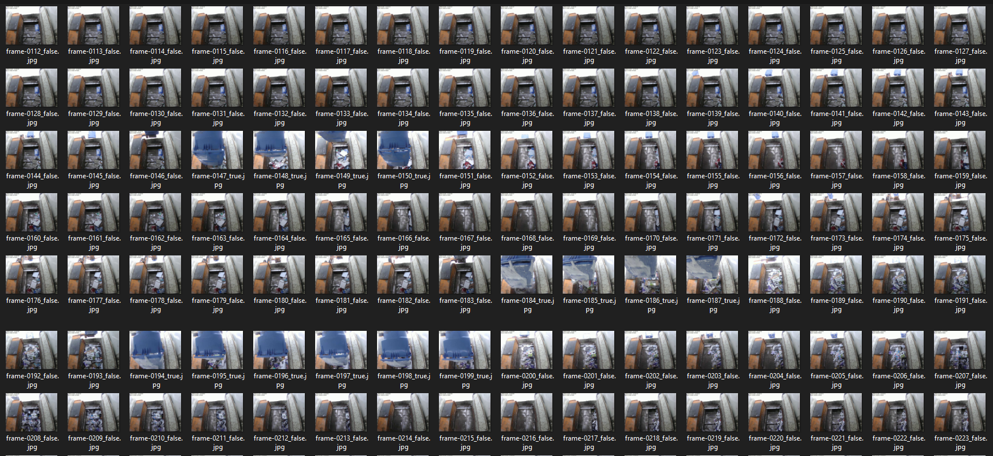
Bin Detector
Notes:
This image shows the bin detection models results for a portion of a bin tip.
As you can see, when a bin enters the camera view, the model predicts those frames as true, the others are predicted false.
This model allows us to trigger SSIO, meaning streamsight input output, to capture the contents of a bin tip within a vehicle hopper.

Slide 14
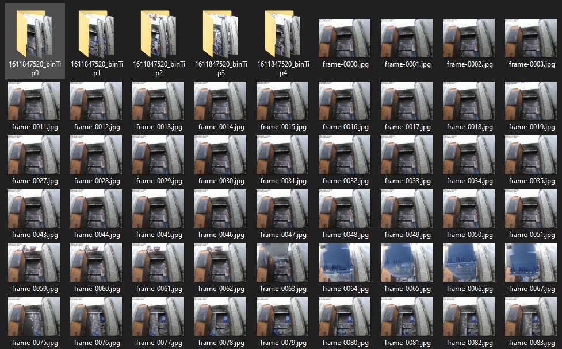
Video to Sample Process
Notes:
Our bin detection model also:
allows us to take previously recorded video
break video down into frames
apply predictions to those frames
group the frames based on the predictions into bin tips
then use those grouped frames as training data for our contaminant classifier

Slide 15
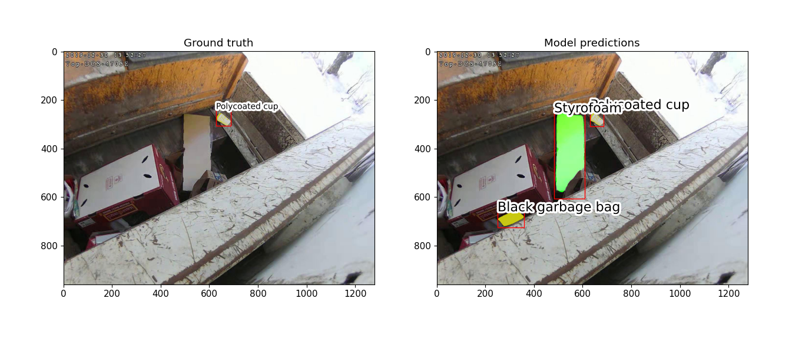
Contaminant Classifier
Notes:
Now I am going to show some of our test predictions from our contaminant classifier.
Here you can see that the model detects the poly coated cup, but then falsely predicts a garbage bag and styrofoam.

Slide 16
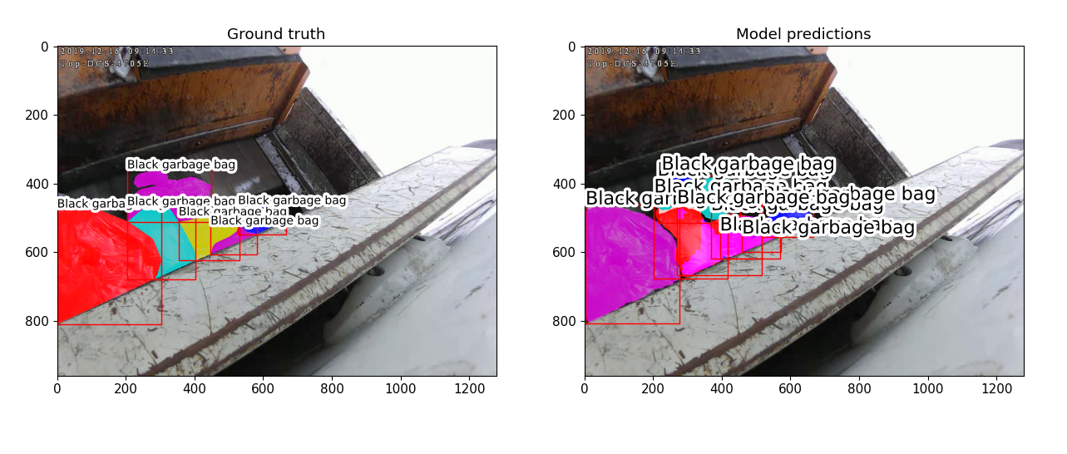
Contaminant Classifier
Notes:
This image shows that the model can detect a class consistently, but may over predict an item.
This prevents using the model to reprimand a household on the number of occurrences of a contaminant, but could still be used to warn the household that a contaminant was detected.

Slide 17
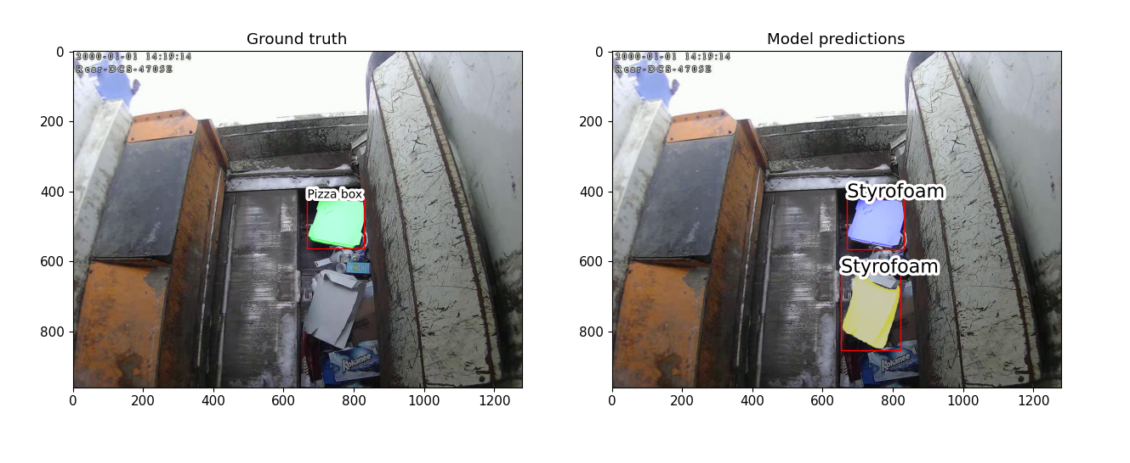
Contaminant Classifier
Notes:
The model struggles to differentiate due to the similarity between styrofoam and a white pizza box.

Slide 18
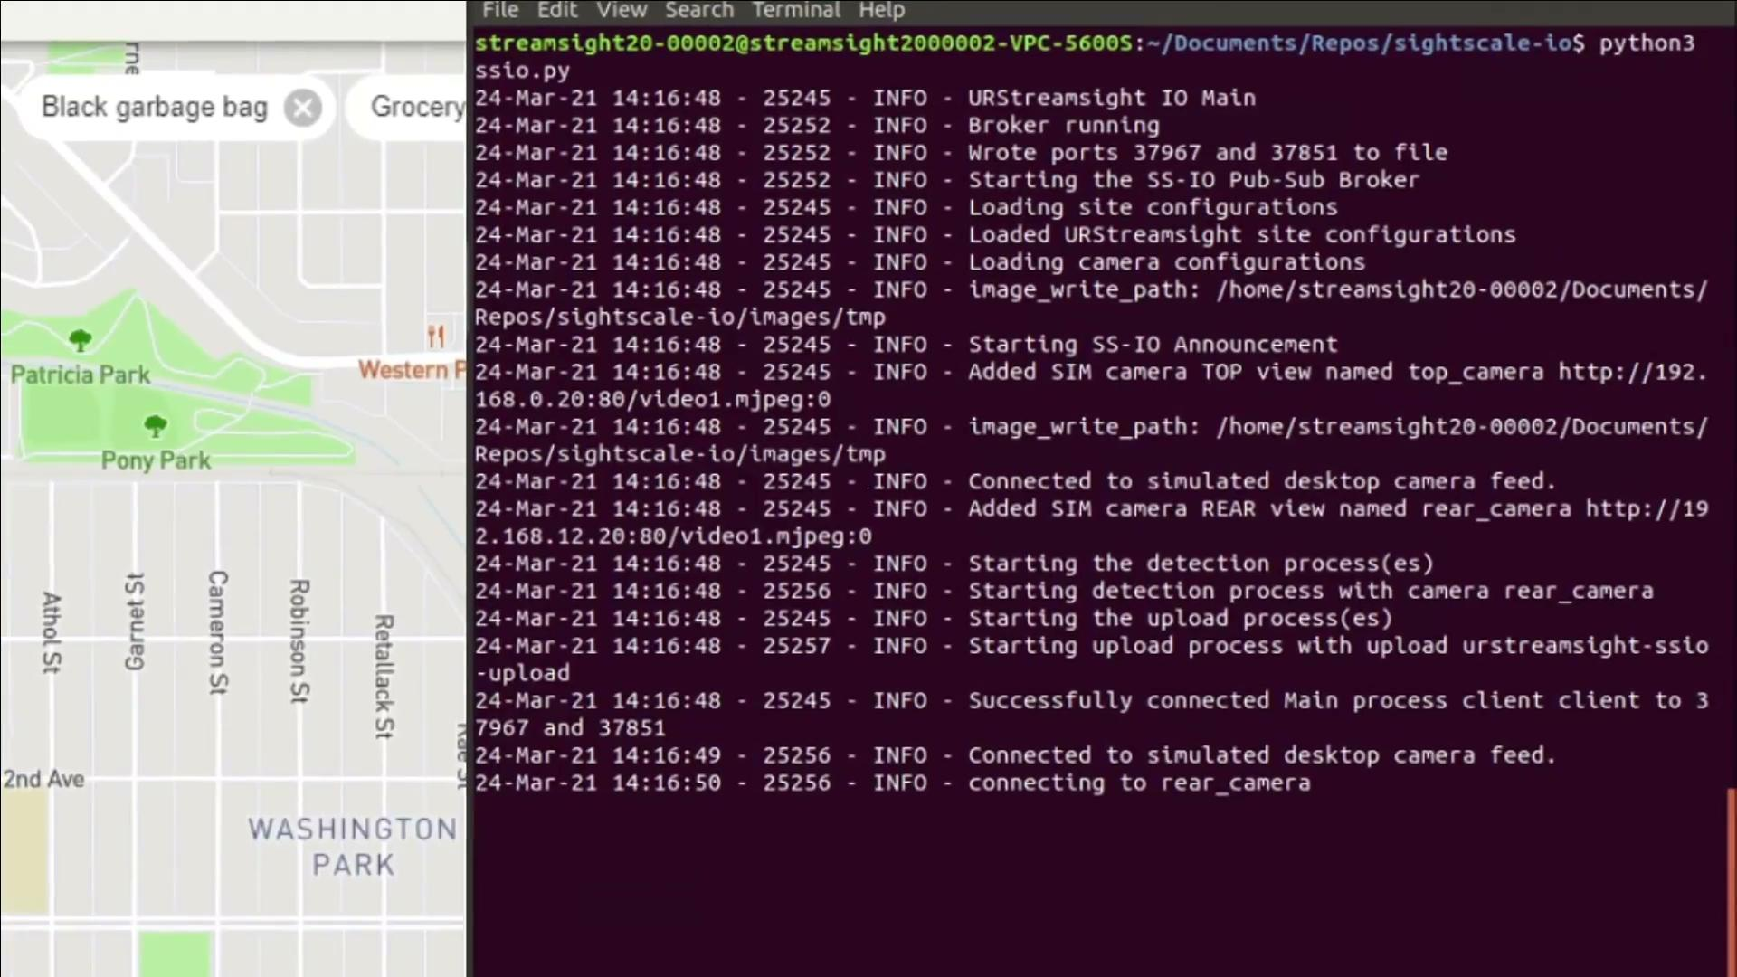
Notes:
Now we will present an end-to-end demo
Here we have some recycling collection footage. We are going to be reading in this video realtime for the purposes of this demo.
On the left you can see the map view of URStreamsight’s front-end. On the right, is a terminal window of the onboard computer running on our collection vehicle.
The terminal will be running SSIO, which stands for Streamsight Input/Output.
If we zoom in here, you can see our logging announcing itself, loading configuration files, establishing write paths, connecting to our cameras, beginning our detection and upload processes, and then connecting to our rear camera which is now ready to detect bin tips.
Now in the terminal window you can see our first bin tip being detected. Following detection, the gps coordinates are logged. Then, images of the hopper are captured until another bin is tipped or a timeout is reached. Then SSIO logs that the bin was completed.
Now the video will speed up through the collection of a few more bin tips. Up until we reach the initial upload event at 5 minutes.
You will notice the seven bin tips that had been detected and saved are now be uploaded to our S3 bucket.
If we zoom in, you can see the Syncing message, this indicates uploading has begun, you can see that the bin tip file has been moved to urstreamsight-ssio-upload which is our S3 bucket on AWS. It then deletes the local copy after upload. Following, the initial upload, each bin tip is uploaded after it is completed.
The video will now speed up as we read in more bin tips and update the map view on URStreamsight. You will notice blue indicators on the heat map. These are contaminants that were detected in the last seven household bin tips. You will also see me toggle the filters on the heat map, which changes the contaminants being displayed indicating that different contaminants were found.
Now, we are going to speed up the video quite a lot to show how the heat map will look after around 30 more households have been collected.
As I update the map view you can see many more contaminants and households are visible on the heat map.
Thanks for watching. We hope this helps understand how URStreamsight works.

Slide 19
Plans For Next Scrum
Ray
API Testing and improvements from Code Review.
Avery
API Testing and changes
CICD Improvement
Noah
Testing and final modifications for SSIO (Streamsight Input/Output)
Further model training for increased performance
Notes:
Ray: My plans will be to finish up API testing and implement some suggested improvements that were given in our code review.
Avery: I plan on adding more tests to the API and adding tests and test coverage to our CI/CD pipeline. I am also going to work on some additional tasks related to the API Code Review feedback.
Noah: I will be working on testing and modifications for SSIO and further model training

Slide 20
Group reflection
Do you feel you are on track?
We feel like we are one track, overall the system is primarily done.
What progress does the team feel particularly great about?
We feel great about the integration between the frontend, backend and ML and the positive feedback from the API code review.
Do you feel there are barriers to your success (if any)?
Pressures of other courses and our model training could delay progress but at the moment things are going smoothly.
Do you need any help going forward?
Tim, we would like to have a meeting regarding how to fit all of our content into our presentation time slot. What is most important to keep?
Any other questions or concerns?
Who needs access to the code, and when? Prairie Robotics would prefer keeping access limited.
Notes:
Ray does first two,
Noah does next two,
Avery does last one
Was this level of description of our project understandable
Was this level of description of our project understandable

Slide 21
Image Refs
https://cleanriver.com/how-to-reduce-recycling-contamination/
https://i.pinimg.com/originals/e9/2c/79/e92c79bbf86dd1295f94bb279fe7152a.jpg
Region of Peel - Study on Enforcement for Reducing Blue Bin Contamination
https://pub-peelregion.escribemeetings.com/FileStream.ashx?DocumentId=4482

Slide 22
Questions or Comments?

